Slide 1

David M. Kroenke and David J. Auer Database Processing: Fundamentals, Design, and Implementation
Chapter Six:
Transforming Data Models into Database Designs

Slide 2
Chapter Objectives
Understand how to transform conceptual model into logical model
AKA: Map conceptual model to logical model
Understand how to represent 1:1, 1:N, and N:M relationships as tables (relations)
Understand purpose and use of referential integrity constraints

Slide 3
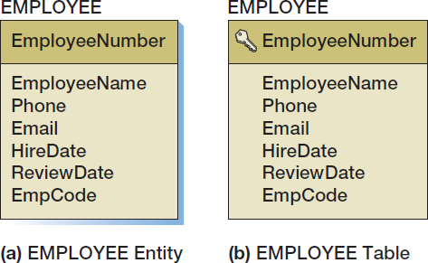
Create a Table for Each Entity
Primary key is designated by the key symbol
Note shadow-less table. Do not need to make shadows for course.

Slide 4
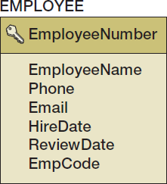
Select the Primary Key
The ideal primary key is short, numeric, and fixed.
Surrogate keys meet the ideal, but have no meaning to users.
Lack of semantics
Notes:
Some database designers take the position that, for consistency, if one table has a surrogate key, all of the tables in the database should have a surrogate key. Others think that such a policy is too rigid; after all, there are good data keys, such as ProductSKU (which would use SKU codes discussed in Chapter 2). If such a key exists, it should be used instead of a surrogate key. Your organization may have standards on this issue that you should follow.
Be aware that DBMS products vary in their support for surrogate keys.
Microsoft Access 2013, Microsoft SQL Server 2014, and MySQL 5.6 provide them.
Microsoft SQL Server 2014 allows the designer to pick the starting value and increment of the key, and MySQL 5.6 allows the designer to pick the starting value.
Oracle’s Oracle Database, however, does not provide direct support for surrogate keys, but you can obtain the essence of them in a rather backhanded way, as discussed in Chapter 10B.
In this book, we use surrogate keys unless there is some strong reason not to. In addition to the advantages described here, the fact that they are fixed simplifies the enforcement of minimum cardinality, as you will learn in the last section of this chapter.

Slide 5
Specify Candidate (Alternate) Keys
The terms candidate key and alternate key are synonymous.
Candidate keys are alternate identifiers of unique rows in a table.
Will use AKn.m notation, where n is the number of the alternate key, and m is the column number in that alternate key.

Slide 6
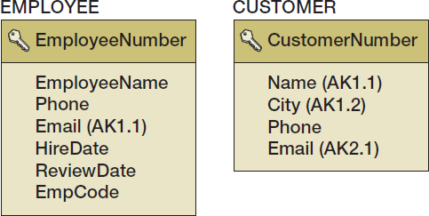
Specify Candidate (Alternate) Keys
Indicates that composite key (name, city) can be used as a key.
Email is in the first (and only column of the second alternative key.

Slide 7
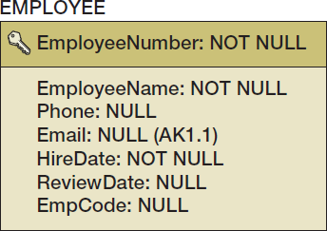
Specify Column Properties: Null Status
Null status indicates whether or not the value of the column can be NULL.
What does null mean exactly?
Important concept
2 interpretations
Notes:
The EMPLOYEE table contains a subtlety.
EmployeeNumber, the primary key, is marked NOT NULL, but Email, the alternate key, is marked NULL.
It makes sense that EmployeeNumber should not be allowed to be null. If it were, and if more than one row had a null value, then EmployeeNumber would not identify a unique row. Why, however, if (1) an alternate key is a candidate key and (2) a candidate key must uniquely identify a row, should Email be allowed to have null values?
The answer is that alternate keys often are used just to ensure uniqueness. Marking Email as a (possibly null) alternate key means that Email need not have a value, but, if it has one, then that value will be unique and different from all other values of Email in the EMPLOYEE table.
This answer is dissatisfying because it means that alternate keys used in this manner are not truly alternate primary keys, and thus neither are they true candidate keys!
Alas, that’s the way it is. Just know that primary keys can never be null but that alternate keys can be.

Slide 8
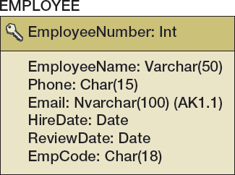
Specify Column Properties: Data Type
Generic data types:
Char(n), Nchar(n)
Varchar(n), Nvarchar(n)
Date
Time
Integer
Decimal(m,n)
Numeric(m,n)
Money(m,n)

Slide 9
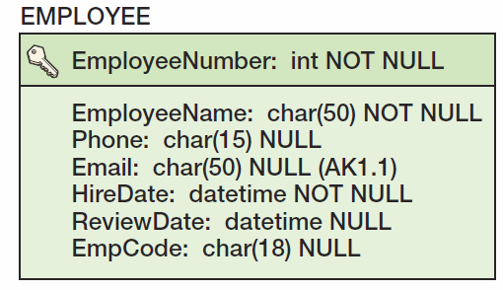
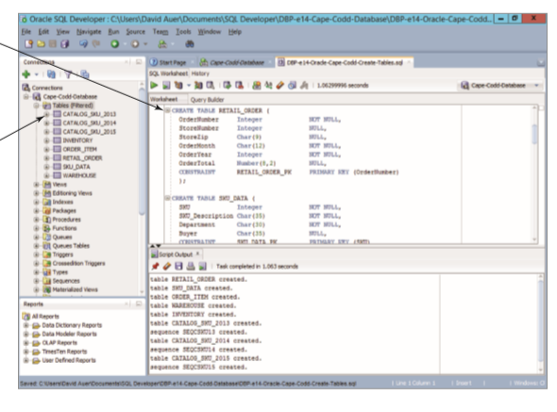
Specify Column Properties: Data Type + Null Status
Check Oracle Syntax: VarChar2(50)
See appendix posted under Oracle.

Slide 10
Specify Column Properties: Data Constraints
Data constraints are limitations on data values:
Domain constraint—column values must be in a given set of specific values.
Range constraint—column values must be within a given range of values.
Intrarelation constraint—column values are limited by comparison to values in other columns in the same table.
Interrelation constraint—column values are limited by comparison to values in other columns in other tables (referential integrity constraints on foreign keys).

Slide 11
Create Relationships: 1:1 Strong Entity Relationships I
Place the primary key of one entity in the other entity as a foreign key.
Either design will work
Minimum cardinality considerations may be important.
.

Slide 12
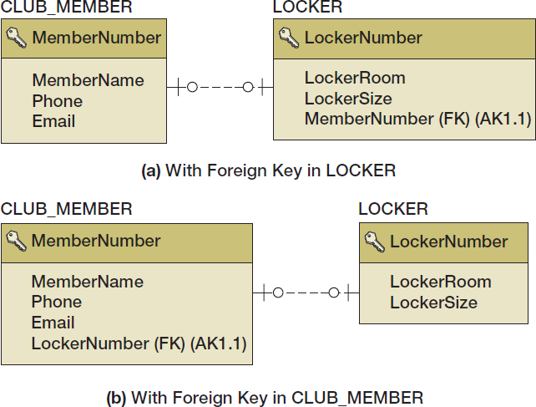
Relationships: 1:1 Strong Entity Relationships II

Slide 13
Relationships: 1:N Strong Entity Relationships I
Place the primary key of the table on the one side of the relationship into the table on the many side of the relationship as the foreign key.

Slide 14
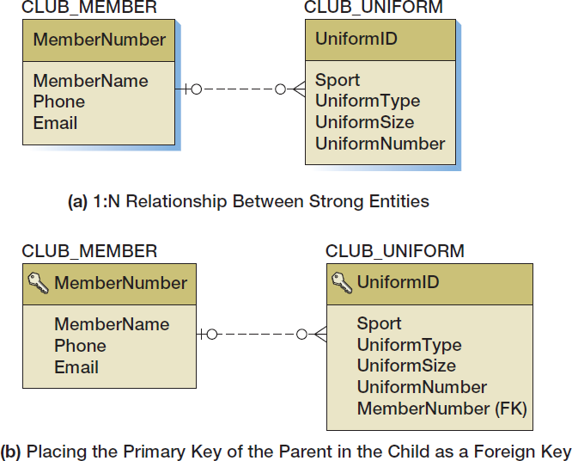
Relationships: 1:N Strong Entity Relationships II

Slide 15
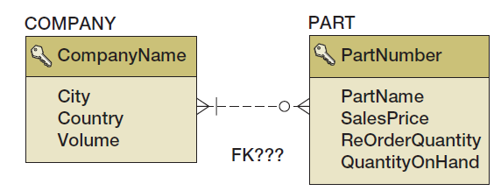
Relationships: N:M Strong Entity Relationships I
In an N:M strong entity relationship there is no place for the foreign key in either table.
A COMPANY may supply many PARTs.
A PART may be supplied by many COMPANYs.

Slide 16
Relationships: N:M Strong Entity Relationships II
The solution is to create a new table that stores data about the corresponding rows from each entity.
The table consists only of the primary keys of each table which form a composite primary key.
Each table’s primary key becomes a foreign key linking back to that table.
COMPANY_PART_INT (CompanyName, PartNumber)
New key is “concatenation” or joining together of keys of involved entities.
Notes:
While we use the term intersection table in this book, this table structure is known by many other names.
In fact, Wikipedia lists 11 alternate names, including intersection table, junction table, bridge table, and association table. While we reserve the term association table for an association relationship (as explained later in this chapter), your instructor may prefer one of the other terms for this table structure.
For more information, see the Wikipedia article Junction table at http://en.wikipedia.org/wiki/Junction_table .
The problem for the data models of N:M relationships between strong entities is that they have no direct representation. N:M relationships must always be decomposed into two 1:N relationships using an intersection table in the database design. This is why products like MySQL Workbench are unable to represent N:M relationships in a data model. These products force you to make the transformation to two 1:N relationships ahead of time, during modeling. As stated in Chapter 5, however, most data modelers consider this requirement to be a nuisance because it adds complexity to data modeling when the whole purpose of data modeling is to reduce complexity to the logical essentials.

Slide 17
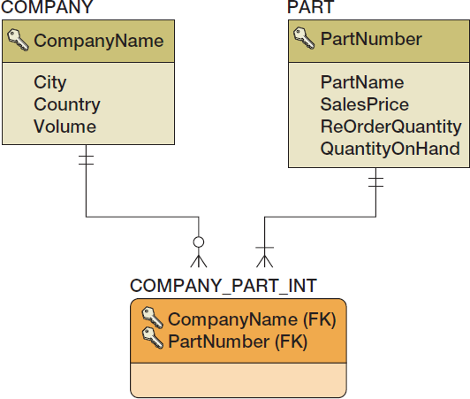
Relationships: N:M Strong Entity Relationships III
COMPANY_PART_INT (CompanyName, PartNumber)

Slide 18
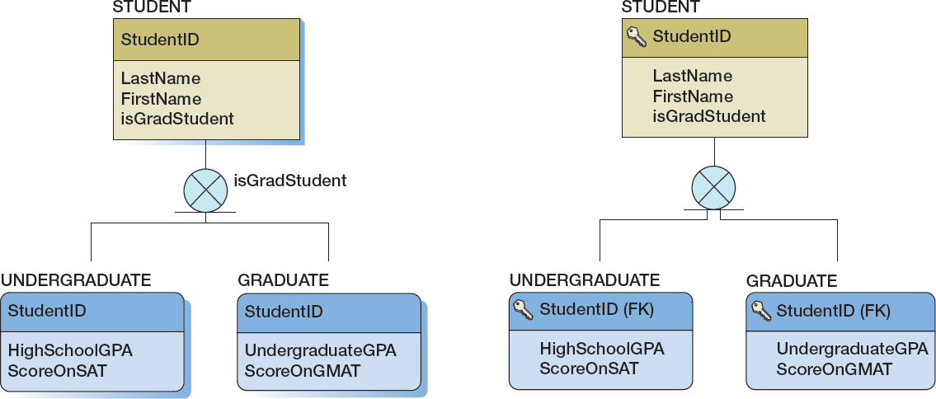
Subtype Relationships
As a data model
As a database design

Slide 19
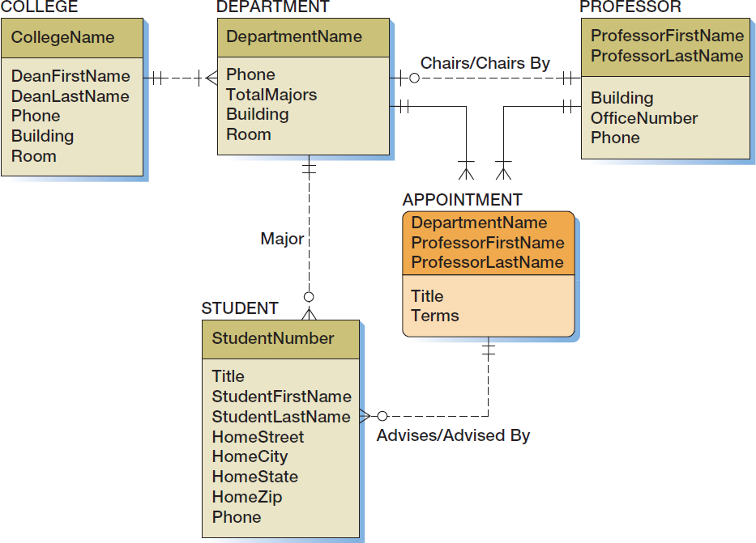
Highline University Data Model

Slide 20
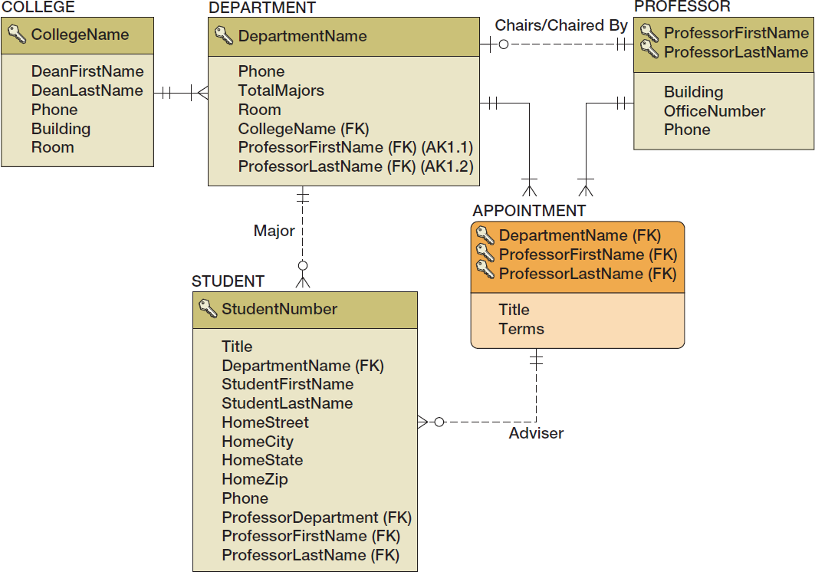
Highline University Database Design

Slide 21
Conclusion
Relational data model
Where in design process?
Transformation of conceptual model
(e.g., ER with crow’s foot notation) to logical model (relational))
Set of rules for performing the transformation (implications of following them?)
Specification of data types
(for implementation)

